Slide 1

A
Presentation on Machine Learning Boosting Algorithms

Slide 2
Agenda
What is Boosting algorithm?
About Ada (Adaptive) algorithm
About XG Boosting
About LG Boosting

Slide 3
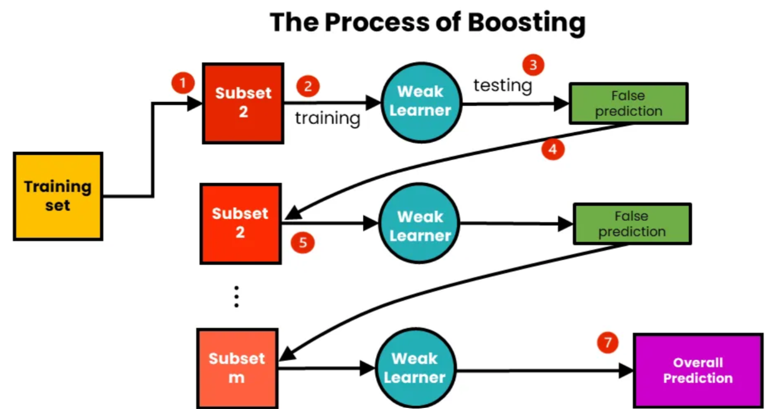
Boosting is a process that uses a set of Machine Learning algorithms to combine weak learner to form strong learners in order to increase the accuracy of the model.

Slide 4
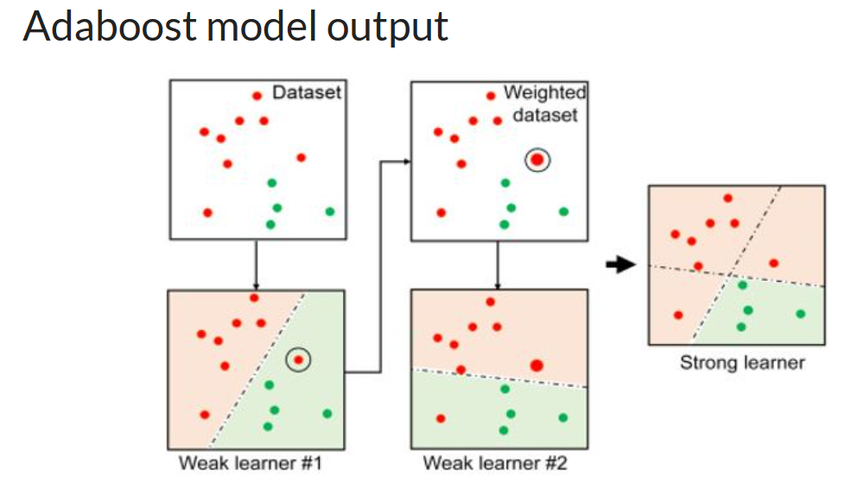
Adaboost (Adaptive boost algorithm)
It gives weights to each data point in the training set based on the accuracy of prior models, and then trains a new model using the updated weights.

Slide 5
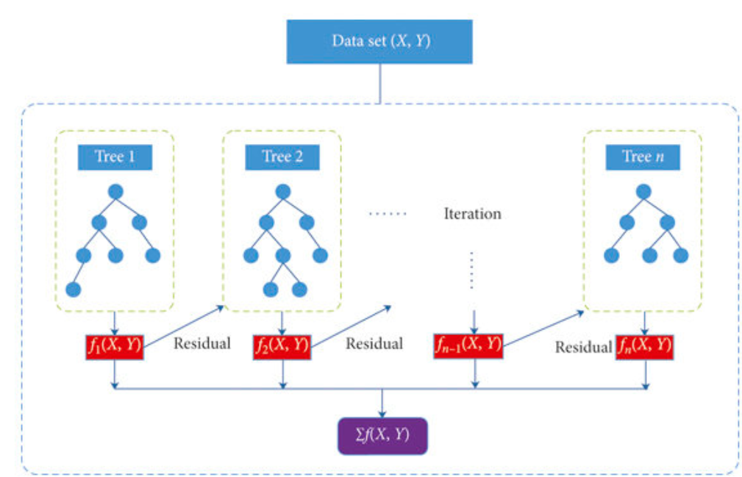
XG Boost algorithm (Extreme Gradient Boosting)
XGBoost works by combining a number of weak learners to form a strong learner.
XGBoost works by training a number of decision trees. Each tree is trained on a subset of the data, and the predictions from each tree are combined to form the final prediction.

Slide 6
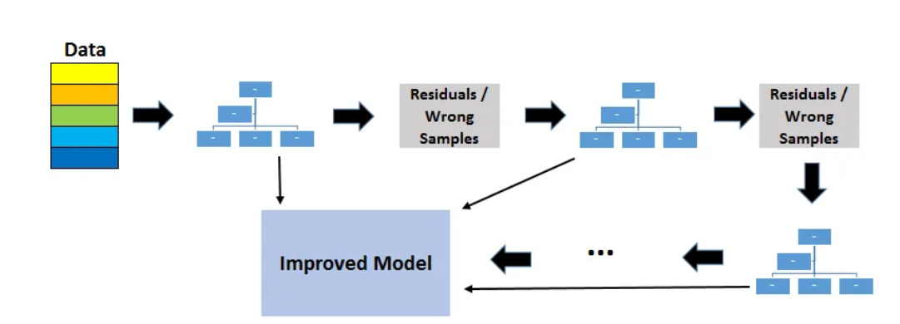
LG Boost algorithm (LightGBM Boosting)
It is a gradient boosting framework that makes use of tree based learning.
Usually algorithms grow trees horizontally and focuses on level/branch wise whereas LightGBM grows vertically meaning it grows leaf-wise.
LightGBM chooses the leaf to lower down more loss than a level wise algorithm when growing the same leaf.

